Slide 1
Steps for Hypothesis testing

Slide 2
STEP 1: Setup hypothesis and determine level of significance
• Setup Null hypothesis (H0) from population parameters
• Setup Alternative hypothesis (Ha)
• Setup appropriate significance level,α

Slide 3
STEP 2:Compute test statistic
From Ha, determine whether this is an upper, lower, or two-tailed test.
Depending on sample size select appropriate sample distribution (T-statistics or Z-statistics. If sample size is less than 30 choose T-statistics else choose Z-statistics
Compute the test statistic.

Slide 4
STEP 3: Determine critical value(Zα) of the test based on alpha ( level of significance)

Slide 5
STEP 4: Compare Z with Zα, and conclude the test

Slide 6
Decision Rule
if I Z l< Zα, Z is not significant and the null hypothesis may, therefore, be accepted. • If I Z I≥ Zα, Z is significant and the null hypothesis is rejected.

Slide 7

Example 1:

Slide 8
POPULATION & PARAMETER
Population = Parents with teenager(13-18)
Parameter of interest = p (population proportion)

Slide 9
Research question

Slide 10
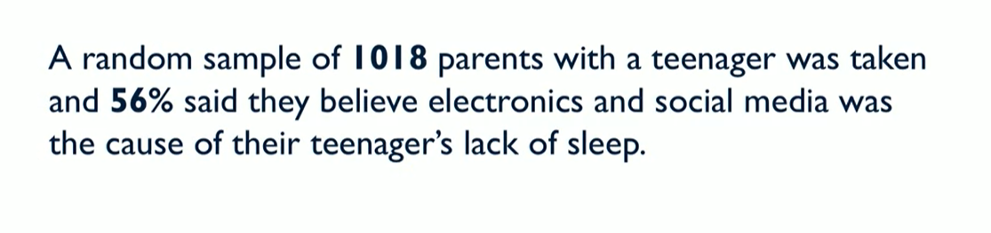
Survey results or sample statistics

Slide 11
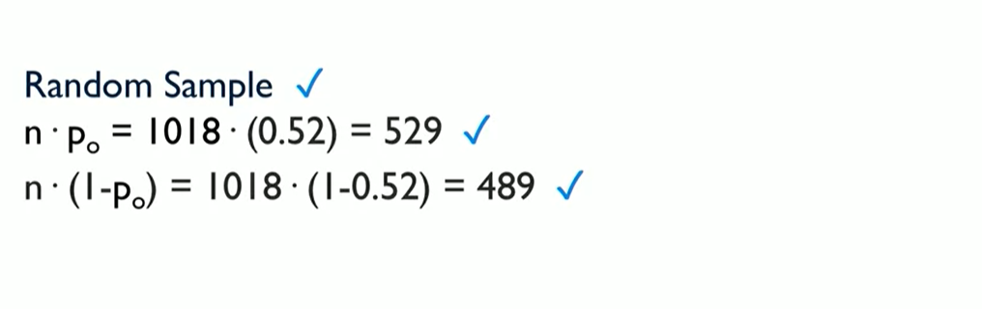
Assumption checking

Slide 12
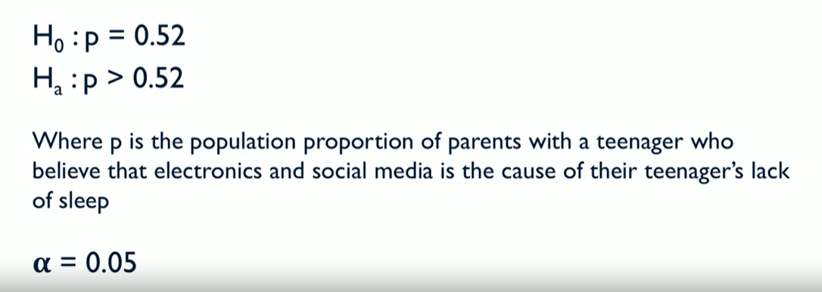
STEP 1:

Slide 13
STEP 2:

Slide 14
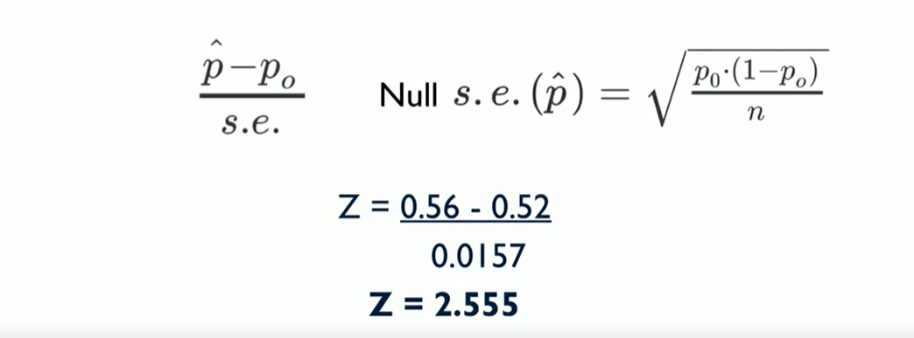
STEP 2:
This is an upper tailed test as Ha is greater than Ho
As sample size is greater than 30 we can compute z-statistics

Slide 15
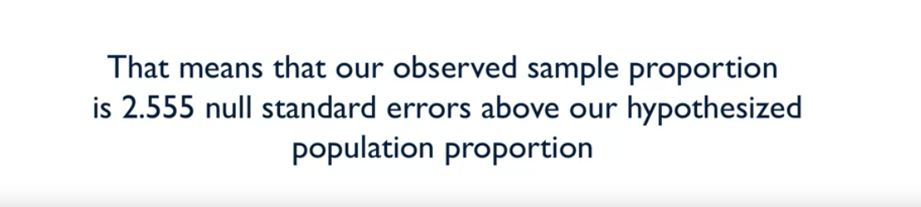
Z score interpretation

Slide 16
Z score interpretation
Now get the Z critical value for significance level 5%. we get 1.64 which is lesser than our z score so we will reject our null hypothesis.
If we get the p value for this Z score we will get .0053 which is lesser than our significance level so we can reject our null hypothesis.

Slide 17

Example 2:

Slide 18
POPULATION & PARAMETER
Population = All parents of black children age(6-18) and all parents of Hispanic children age(6-18)
Parameter of interest =P1-P2

Slide 19
Research question

Slide 20
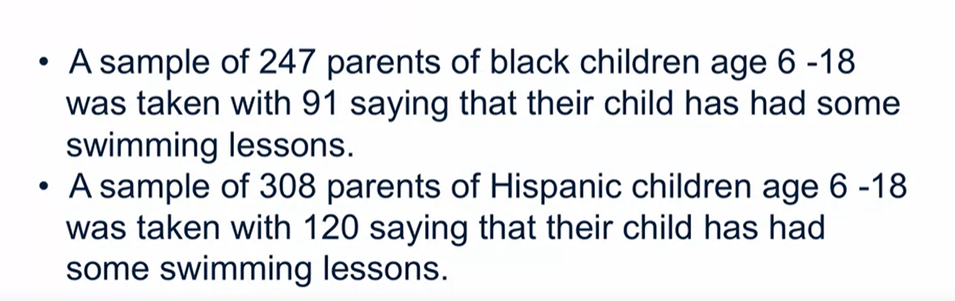
Survey results or sample statistics

Slide 21
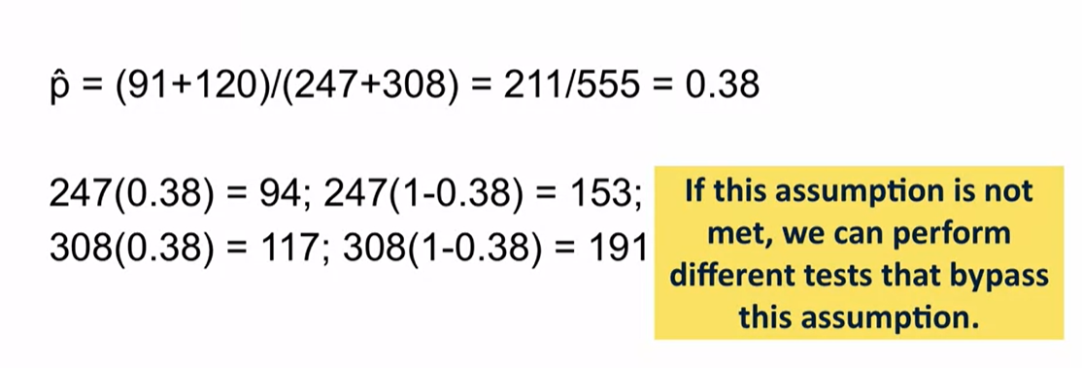
Assumption checking

Slide 22
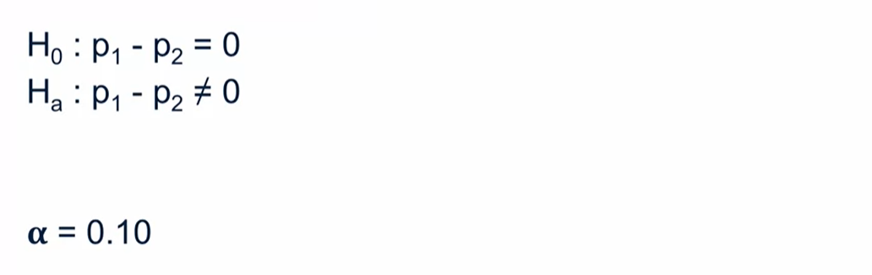
STEP 1:

Slide 23
STEP 2:

Slide 24
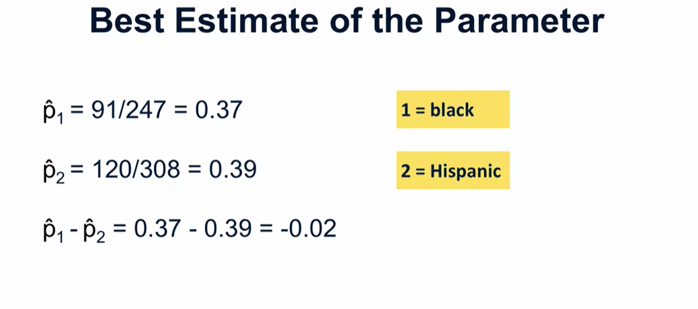
Best estimate of populations

Slide 25
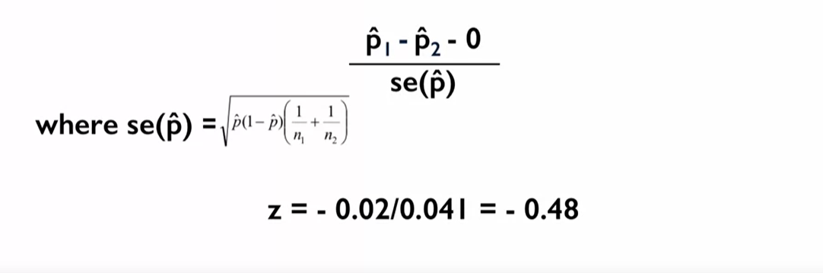
STEP 2:
This is an two tailed test as Ha is not equal to Ho
As sample size is greater than 30 we can compute z-statistics

Slide 26
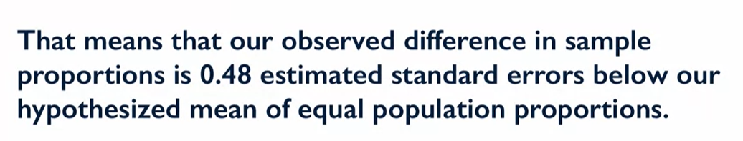
Z score interpretation

Slide 27
Z score interpretation
Now get the Z critical value for significance level 5%. we get 1.64 which is greater than our z score so we cant reject our null hypothesis. That does not mean we accept the null hypothesis we can conclude that there is no significance difference between these two population proportions.
If we get the p value for this Z score we will get .63 which is greater than our significance level so we can’t reject our null hypothesis.

Slide 28
Example 3:

Slide 29
POPULATION & PARAMETER
Population = All adults
Parameter of interest =population mean cartwheel distance

Slide 30

Research question

Slide 31
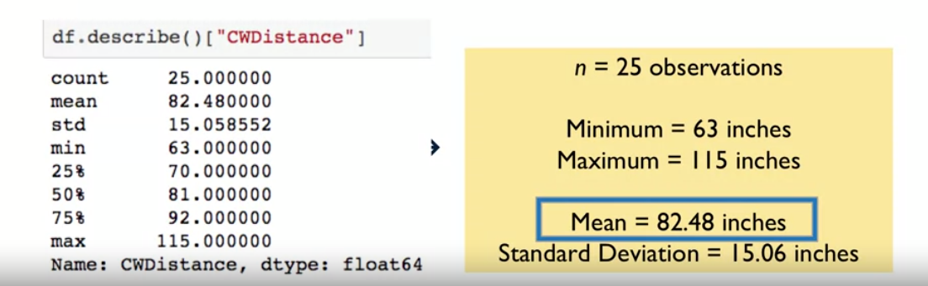
Survey results or sample statistics

Slide 32
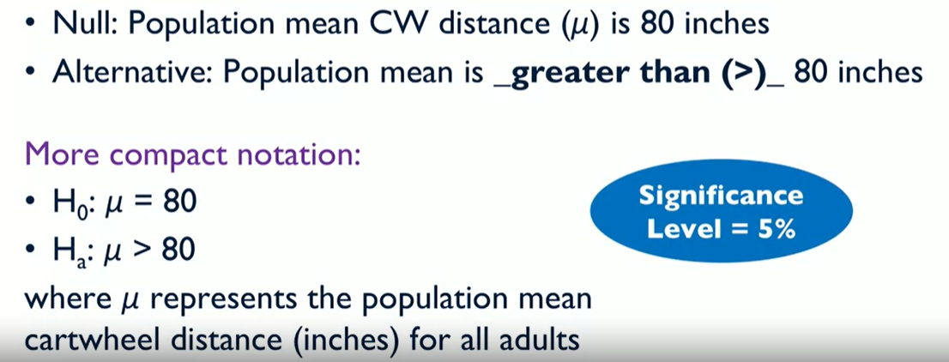
STEP 1:

Slide 33
STEP 2:

Slide 34
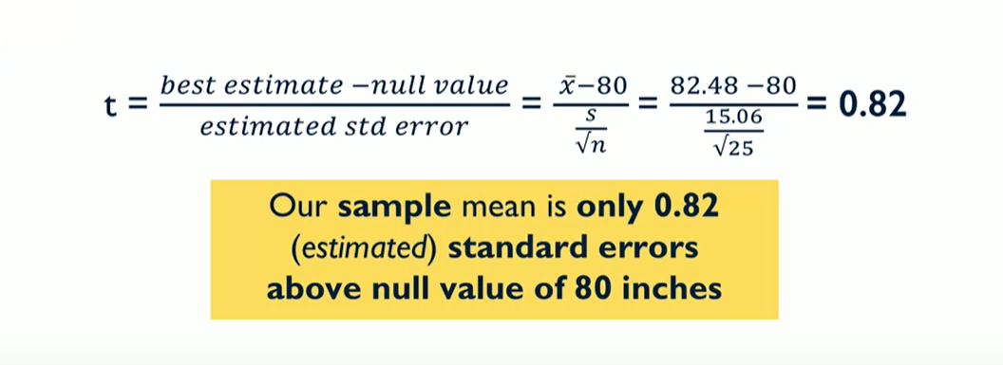
STEP 2:
This is an upper tailed test as Ha is greater than Ho
As sample size is less than 30 we can compute T-statistics

Slide 35
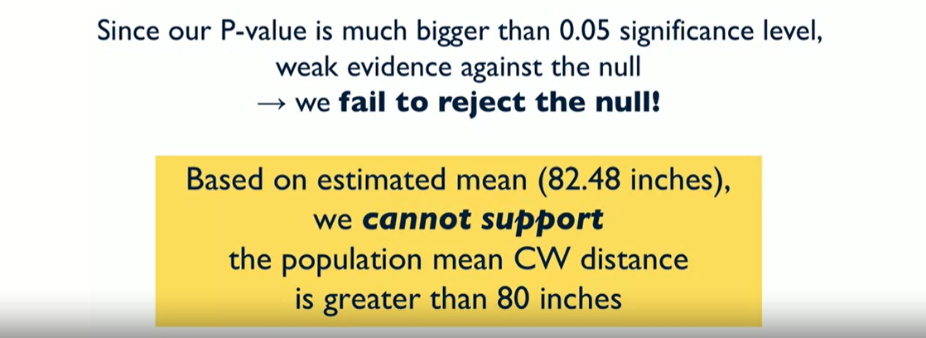
T score interpretation

Slide 36
T score interpretation
Now get the T critical value for significance level 5% with degrees of freedom (N-1)=24. we get 1.711 which is greater than our T score so we cant reject our null hypothesis. That does not mean we accept the null hypothesis we can conclude that there is no significance increment in mean distance.
If we get the p value for this T score we will get .21 which is greater than our significance level so we can’t reject our null hypothesis.

